Slide 1
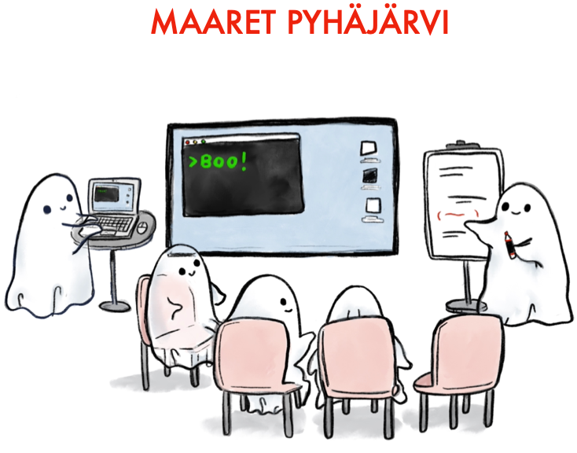
Ensemble Manual Testing
“All the brilliant people working on the same thing, at the same time, in the same place, and on the same computer.”
Woody Zuill

Slide 2
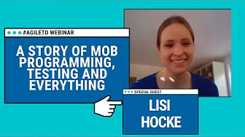
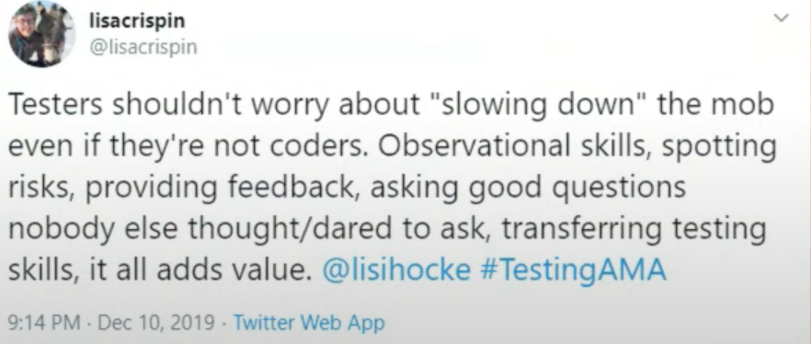
https://www.youtube.com/watch?v=KYVWqQwlWNw

Slide 3
Testing teams
Generally, tasks are assigned to the team with one of the most knowledgeable developers for that task. E.g. Richard –Sliceviewer (these people were testing anyway)
Spread based on sub-team, lead, OS availability.

Slide 4
As Usual…
Run through the testing documentation
Go beyond and think of unexpected ways to push Workbench
Note problems in the issue as you find them.

Slide 5
Experimenting!
Driver that screen shares the role rotates on each section. How strict will roles be?
Bonus that I want to try: Create an IDAaaS session and share with team members → hopefully faster transition of roles.
Core testing previously 4 testers. Same again but now all testers are on separate computers with separate OS (Windows, Ubuntu, IDAaaS, MacOS), and on the same call!
If there’s time try to raise issues for serious enough bugs as you find them!

Slide 6
Questions I will ask later
How strictly did your team stick to driver / navigator roles? Was this good / bad?
Was it any better / worse for the most knowledgeable person to be the driver / navigator?
Have you found any gaps in testing docs?
Are you testing better?
Is testing more fun?

Slide 7
To start:
Pick a large tasks first
Decide if there is a most important OS for testing
Download latest “nightly” from the pipeline: https://builds.mantidproject.org/view/Main%20Pipeline/
Pick a first driver and go for it!
Test until 2:45pm, then I will call everyone back for some initial feedback before a break

